Slide 1
Advantage
U.S. Soccer Federation Referee Program
Grade 7 Referee Course
Amateur Adult Training
Notes:
Online Training Script:
Welcome to U.S. Soccer’s online training for the Grade 7 Referee Course.
Training for this course is specific to preparing officials for the amateur adult game.
This presentation focuses on advantage.
Classroom Instructor Talking Points:

Slide 2
Laws of the Game
The Referee:
Allows play to continue when the team against which an offense has been committed will benefit from such an advantage and penalizes the original offence if the anticipated advantage does not ensue at that time
Notes:
Online Training Script:
Law 5 empowers the referee to apply advantage when the team that was offended will continue to benefit.
Referees need to understand that the advantage clause is applicable at the referee’s discretion.
Applying advantage used to be confined to fouls and misconduct described in Law 12 but this has since been expanded to cover any infringement or offense committed while the ball is in play.
Classroom Instructor Talking Points:

Slide 3
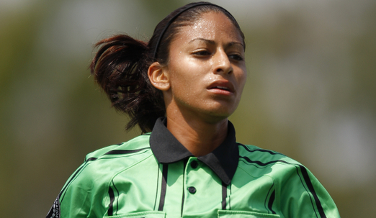
Examples
Notes:
Online Training Script:
Please review the following examples of when advantage should and should not be applied.
Classroom Instructor Talking Points:

Slide 4
Example
Red team player takes a free kick but then touches the ball again before it has been touched by another player
Red team player’s second touch plays the ball to blue team player
Blue team player begins to attack the red team’s goal
Apply advantage
Notes:
Online Training Script:
A player from the red team takes a free kick but then violates the Laws of the Game by touching the ball a second time before it has been touched by another player.
This second touch delivers the ball to the opposition who then begins to attack the red team’s goal.
In this scenario, the referee should apply advantage because the violation of the law has benefitted the team who the infringement was committed against.
If the referee stops play and awards the free kick to the blue team before the play develops, the opportunity to stage a promising counterattack has been negated.
Classroom Instructor Talking Points:

Slide 5
Example
Red team player takes a throw-in but has both feet completely within the field of play
The ball goes to blue team player who begins promising attack to the red team’s goal
Advantage not applied
Throw-in awarded to blue team
Notes:
Online Training Script:
A player from the red team delivers a throw-in illegally.
The illegal throw-in goes directly to the opposition and leads to a promising attacking opportunity.
In this scenario, play must be stopped and the throw-in awarded to the blue team because advantage cannot be applied when the ball is not in play.
From the taking of a throw-in, the ball is not in play if delivered illegally.
Classroom Instructor Talking Points:

Slide 6
Example
Red team player plays the ball to a teammate
Offside position
Involved in active play
Blue team goalkeeper collects the ball and then distributes to begin counterattack
Apply advantage
Notes:
Online Training Script:
A player from the red team plays the ball to a teammate in an offside position who is also involved in active play.
Despite the offside offense, the goalkeeper from the blue team collects the ball and delivers it up field to begin a promising counterattack.
In this case, the referee should not stop play and allow for advantage.
Classroom Instructor Talking Points:

Slide 7
Considerations
Game control versus game flow
4 P principle
Possession
Potential for attack
Personnel
Proximity to goal
Wait and see
Misconduct
Notes:
Online Training Script:
Properly applying advantage to promote attacking soccer is at the core of the Laws of the Game.
To this end, the referee is tasked with deciding between stopping play for an offense or applying advantage and allowing play to continue.
When doing this, he or she must take into consideration game control versus game flow, the 4 P’s principle, the understanding of 2-3 seconds and the impact of cautions or send offs.
In addition, given the experience and skill level of the players, properly applying advantage is crucial for success for referees working the amateur adult game.
Classroom Instructor Talking Points:

Slide 8
Control and Flow
Game control
Enforcing the Laws of the Game
Game flow
Tempo and pace of the game
Notes:
Online Training Script:
Game control refers to the stoppages the referee makes to enforce the Laws of the Game.
Game flow refers to the game’s tempo or pace.
The fewer stoppages, the more free flowing the game is, while more stoppages usually results in a reduced game flow.
Classroom Instructor Talking Points:

Slide 9
Balance
Apply advantage to allow for game flow while also allowing for the option to stop play for game control
Vital to the amateur adult game
Develops with experience
Notes:
Online Training Script:
Game flow is important but not stopping the game for fouls can cause frustration and lead to problems.
In contrast, the failure to stop the game for offences can diminish the referee’s control over the game.
Striking an appropriate balance between game flow and game control should be the objective of referees working the amateur adult game.
Being able to manage a game and find this balance comes with experience and referees should be mindful of this when they begin officiating at this level.
Ultimately, applying advantage is one way a referee can help promote this balance.
Classroom Instructor Talking Points:

Slide 10
4 P Principle
Possession of the ball
Control by team or player
Potential for attack
Ability to continue a promising attack
Personnel
Skill of attackers, numerical advantage
Proximity to the opponent's goal
Notes:
Online Training Script:
The 4 P Principle is a key consideration for referees when determining if advantage is present.
The referee must consider if there is credible control by the player who was fouled or a teammate.
The referee is expected to apply advantage if the fouled player's team is able to retain control of the ball as part of a developing or promising attack.
It is also necessary for the referee to consider the skill level of the players, the tempo of the game and the playing conditions before making use of this clause.
Referees must also determine if there is space for the player to progress toward goal for a successful attack and if they are close enough to goal to do so.
Classroom Instructor Talking Points:

Slide 11
Wait and See
Assess the situation
Wait 2-3 seconds to see if the play develops
Signal for advantage
If the attack doesn’t develop
Stop play and award a free kick for the original offense
Notes:
Online Training Script:
After applying advantage the referee should wait for 2-3 seconds to see if the play continues to develop.
The referee may stop play in order to penalize the original foul if the advantage situation does not develop after these 2-3 seconds.
In the event that the advantage is wasted as a result of a subsequent error by the attacking team, such an errant pass or missed shot, then play should not be halted to penalize for the original offence.
Classroom Instructor Talking Points:

Slide 12
Misconduct
Independent from applying advantage
At next stoppage
Issue misconduct
Ensure the misconduct is clear to both teams
Serious foul play offenses
No advantage unless there is an obvious and immediate goal scoring opportunity
Notes:
Online Training Script:
An offense by a player of the offending team must not be ignored while the referee allows the anticipated development of the advantage.
Such an offense may either be recognized by stopping play immediately or by applying advantage.
Regardless of the outcome of the advantage, the referee must deal appropriately with any misconduct at the next stoppage, before allowing play to be restarted.
Note that referees should not apply advantage for serious foul play offenses unless there is an obvious and immediate opportunity to score a goal.
Classroom Instructor Talking Points:

Slide 13
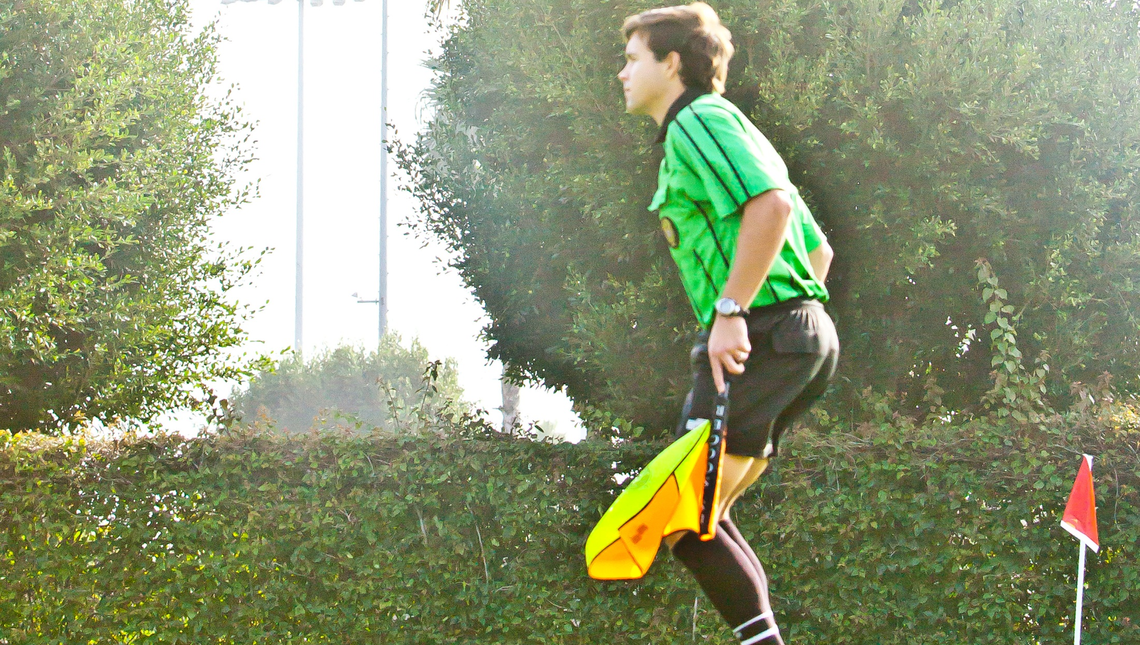
Assistant Referees
Notes:
Online Training Script:
While advantage is only stated in Law 5, in the case of fouls or misconduct not seen by the referee, the assistant referee also needs to determine whether or not to apply advantage.
While there is no advantage signal for assistant referees, they indicate advantage by choosing to not signal with the flag and instead, waiting to see if the play develops.
Again, if the play does not develop within 2-3 seconds, the assistant referee can then signal for the original offense.
This assistant referee duty should be addressed during the pre-game conference.
Classroom Instructor Talking Points:

Slide 14
Review Question
When applying advantage, what factors should the referee consider?
Possession of the ball
Potential for attack
Proximity to the opponent’s goal
All of the above
Notes:
Online Training Script:
Classroom Instructor Talking Points:

Slide 15
Review Question
Can effectively applying advantage assist referees with managing game control?
Yes
No
Notes:
Online Training Script:
Classroom Instructor Talking Points:

Slide 16
Review Question
Does applying advantage only relate to fouls and misconduct?
Yes
No
Notes:
Online Training Script:
Classroom Instructor Talking Points:

Slide 17
Review Question
Should the referee apply advantage if the fouled player’s team is able to retain control of the ball as part of a developing or promising attack?
Yes
No
Notes:
Online Training Script:
Classroom Instructor Talking Points:

